Slide 1
Image Caption in CVPR’17
SHUYAN LI

Slide 2
i-VisionGroup
Tsinghua
Overview
Main focus:
Reinforcement learning: 2
Use extra Attributes: 3
attention: 2
Video: 3
Word detection + retrieval: 1
Dense caption: 2

Slide 3
i-VisionGroup
Tsinghua
Deep Reinforcement Learning-based Image Captioning with Embedding Reward
Authors: Zhou Ren Xiaoyu Wang Ning Zhang Xutao Lv Li-Jia Li
Lab: Snap Research
Source: CVPR’17(Oral)

Slide 4
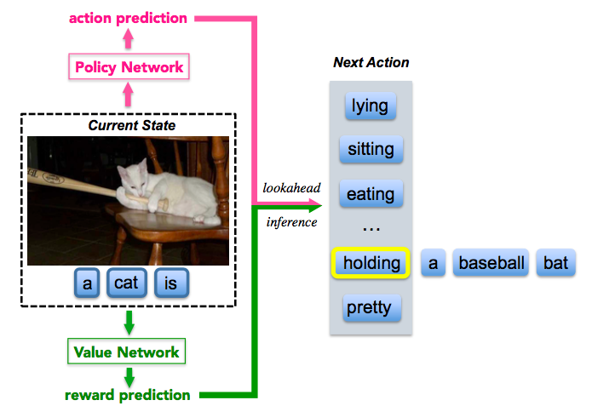
i-VisionGroup
Tsinghua
Contributions
policy network
Decision-making framework
Actor-critic model with reward driven by
visual-semantic embedding
Lookahead inference with policy network
and value network
value network
Deep Reinforcement Learning-based Image Captioning with Embedding Reward

Slide 5
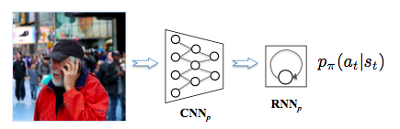
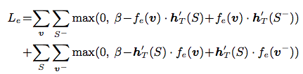
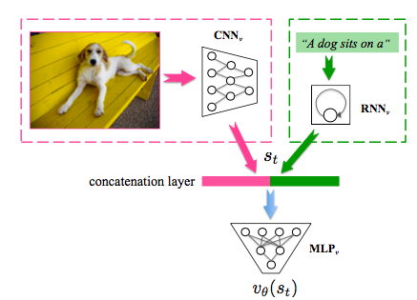
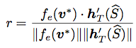
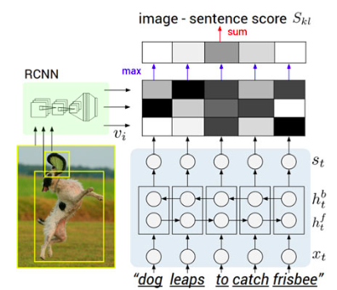
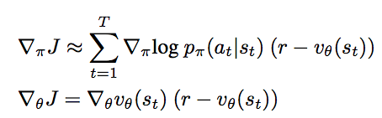
i-VisionGroup
Tsinghua
Method
Policy network to calculate p_{π}(a_{t}|s_{t}):
Value network to calculate v_{θ}(s_{t}) :
Apply visual-semantic embedding as reword r:
Train embedding model
Calculate embedding similarity:
Deep Reinforcement Learning-based Image Captioning with Embedding Reward

Slide 6
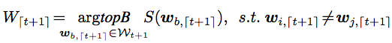
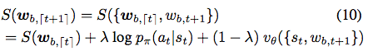
i-VisionGroup
Tsinghua
Tricks
Curriculum learning while training:
iteratively we fix the first (T − i × ∆) words with cross entropy loss and let the actor-critic model train with the remaining i × ∆ words, for i = 1, 2, ..., until reinforcement learning is used to train the whole sentence
Beam search + lookahead reward while inference:
Define scoring function:
Deep Reinforcement Learning-based Image Captioning with Embedding Reward

Slide 7
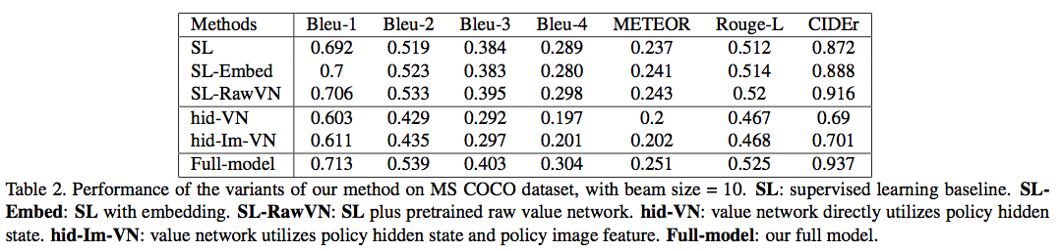
i-VisionGroup
Tsinghua
Experimental Result
Deep Reinforcement Learning-based Image Captioning with Embedding Reward

Slide 8
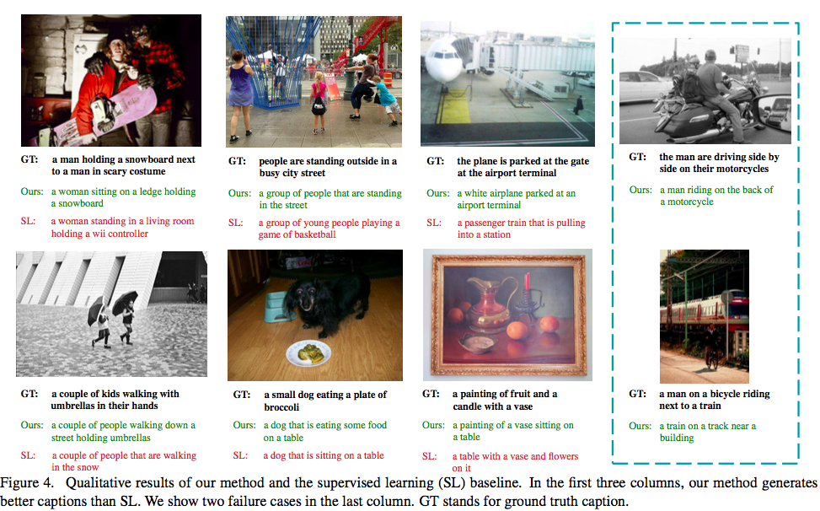
i-VisionGroup
Tsinghua
Experimental Result
Deep Reinforcement Learning-based Image Captioning with Embedding Reward

Slide 9
i-VisionGroup
Tsinghua
Self-critical Sequence Training for Image Captioning
Authors: Steven J. Rennie Etienne Marcheret Youssef Mroueh Jarret Ross
Lab: IBM Watson Multimodal Algorithms and Engines Group
Source: CVPR’17 (spotlight)

Slide 10
i-VisionGroup
Tsinghua
Contribution
Contributions:
1.Use output of its own test time inference as baseline
2.Directly optimize on CIDEr
3.test on NIC & Att2in model
Problems to solve:
Mismatch between training and testing
Trained using the cross entropy loss, while
typically evaluated at test time using discrete
and non-differentiable NLP metrics
Self-critical Sequence Training for Image Captioning

Slide 11
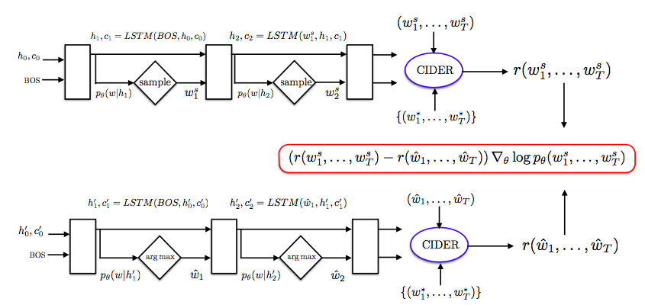
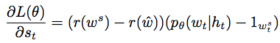
i-VisionGroup
Tsinghua
Method&Tricks
Solution:
baseline the REINFORCE algorithm with the reward obtained by the current model under the inference algorithm used at test time
1.Pretraining under XE objective and select the one with best CIDEr as the initialization for SCST
2.Ensemble of 4 models
Self-critical Sequence Training for Image Captioning

Slide 12
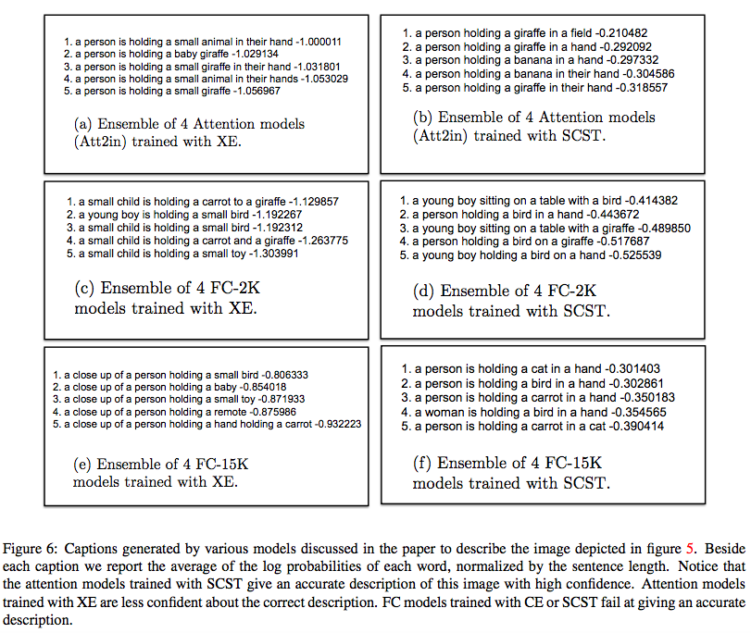
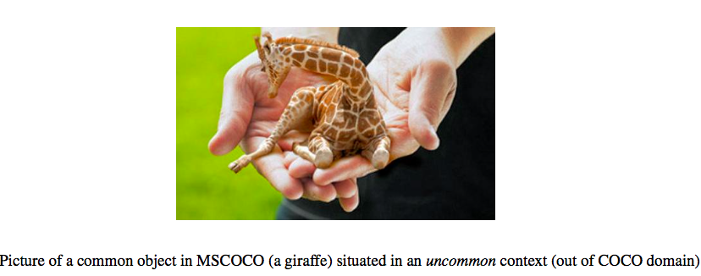
i-VisionGroup
Tsinghua
Experimental Result
Self-critical Sequence Training for Image Captioning

Slide 13
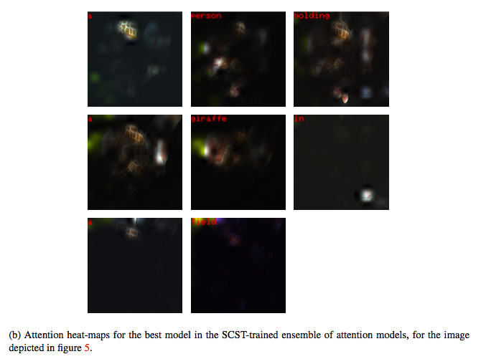
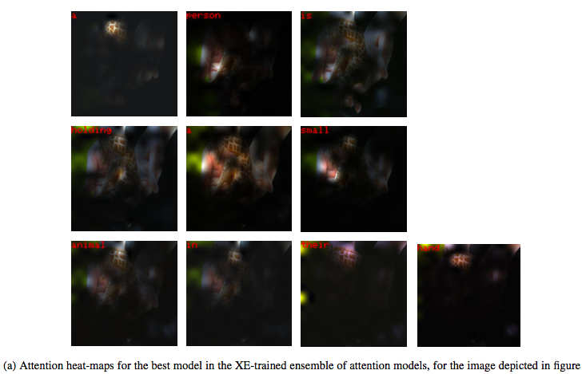
i-VisionGroup
Tsinghua
Experimental Result
Self-critical Sequence Training for Image Captioning

Slide 14
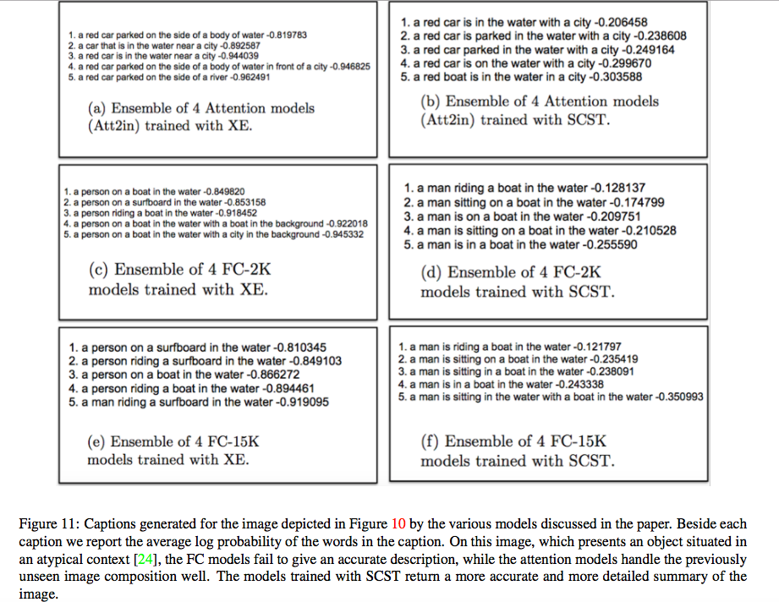
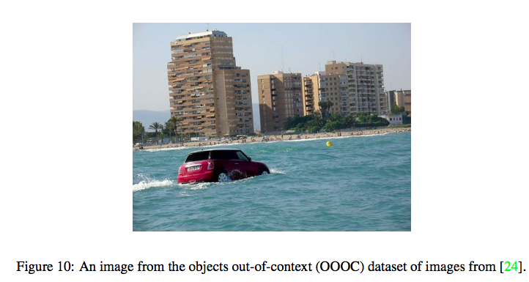
i-VisionGroup
Tsinghua
Experimental Result
Self-critical Sequence Training for Image Captioning

Slide 15
i-VisionGroup
Tsinghua
Knowing When to Look: Adaptive Attention via A Visual Sentinel for Image Captioning
Authors: Jiasen Lu Caiming Xiong Devi Parikh
Lab: Virginia Tech Computer Vision Lab Salesforce
Source: CVPR’17 (spotlight)

Slide 16
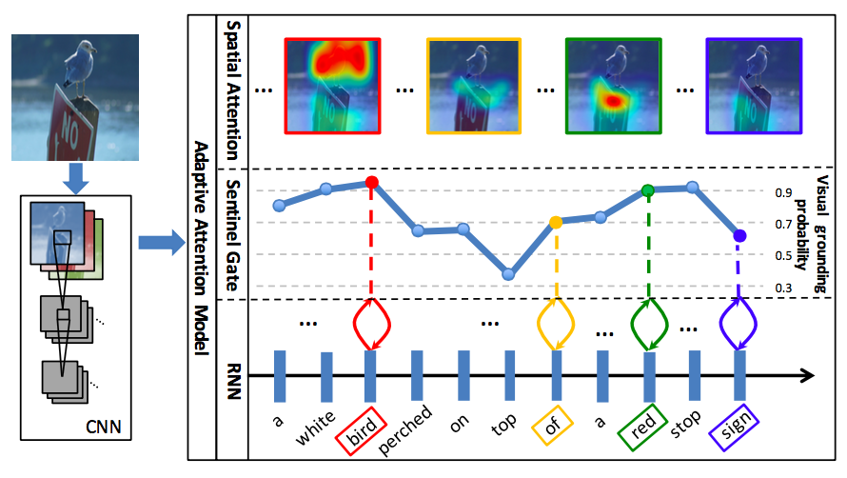
i-VisionGroup
Tsinghua
Contribution
Image information is not needed when:
No-visual information such as “the”
Visual word which can be predict reliably from the language model.
Contributes:
A new spatial attention model
Decide when to look at the image
Knowing When to Look: Adaptive Attention via A Visual Sentinel for Image Captioning

Slide 17
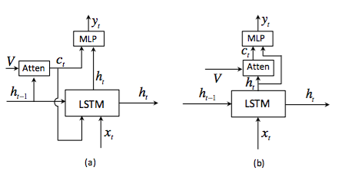
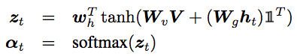
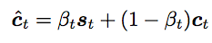
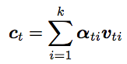
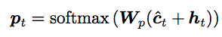
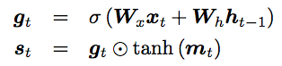
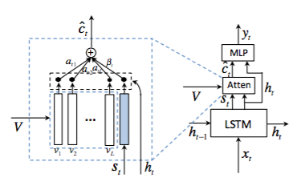

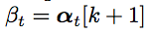
i-VisionGroup
Tsinghua
Method
Model (b) compared with s&h attend(a)
Calculate context vector c_{t} :
The mixture model is:
The probability of
possible words:
Obtain “visual sentinel” vector s_{t}
Add “visual sentinel”
where m_{t} is the memory cell
calculateβ_{t} :
Knowing When to Look: Adaptive Attention via A Visual Sentinel for Image Captioning

Slide 18
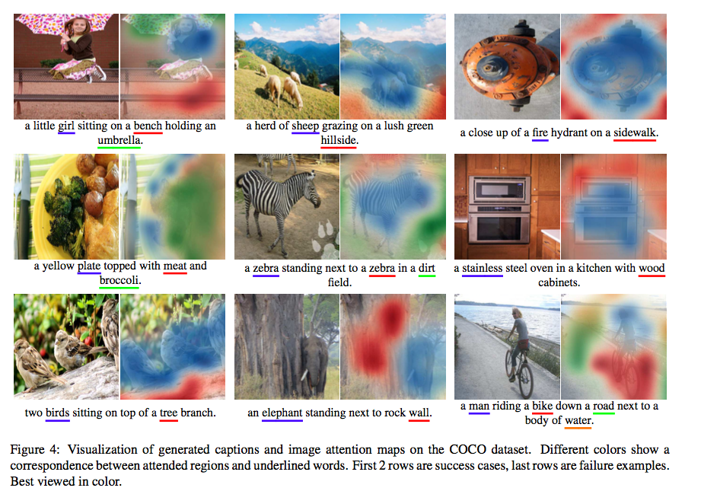
i-VisionGroup
Tsinghua
Experimental Result
Knowing When to Look: Adaptive Attention via A Visual Sentinel for Image Captioning

Slide 19
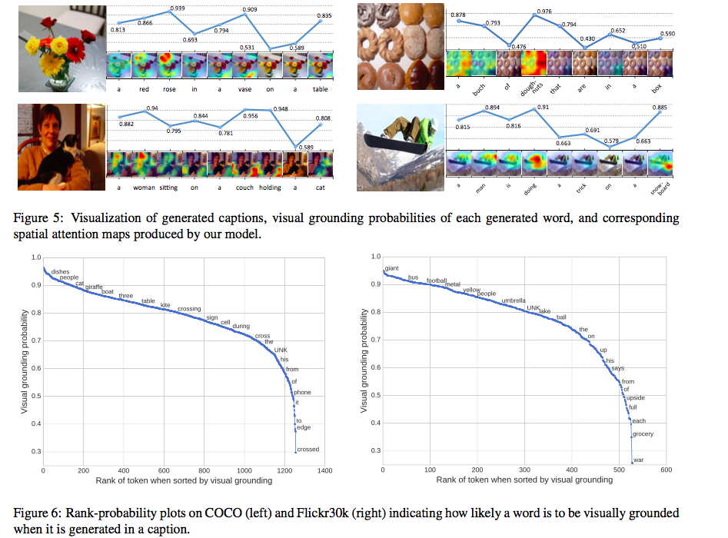
i-VisionGroup
Tsinghua
Experimental Result
Knowing When to Look: Adaptive Attention via A Visual Sentinel for Image Captioning

Slide 20
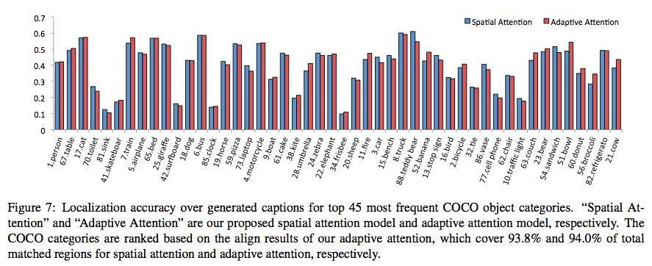
i-VisionGroup
Tsinghua
Experimental Result
Knowing When to Look: Adaptive Attention via A Visual Sentinel for Image Captioning

Slide 21
i-VisionGroup
Tsinghua
Semantic Compositional Networks for Visual Captioning
Authors: Zhe Gan Chuang Gan Xiaodong He Yanchen Pu Jianfeng Gao
Lab: Microsoft Research Redmond Lab
Source: CVPR’17 (spotlight)

Slide 22
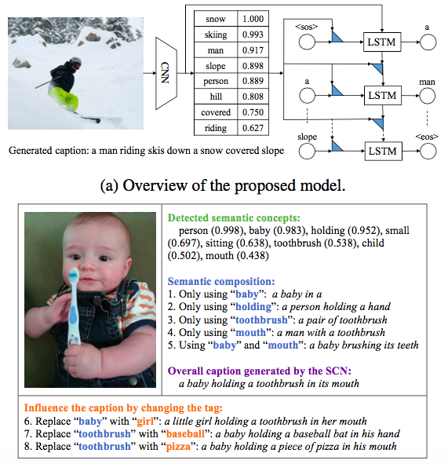
i-VisionGroup
Tsinghua
Contributions
Use the semantic concept vector to weight the basis LSTM weight matrices in the ensemble
Extension to video caption
Generate novel captions that are highly unlikely to occur in real life
Semantic Compositional Networks for Visual Captioning
Notes:
semantic concept vector = attribute
从一张图片中提取出可能包含的词，不同于一般的object detection，它的词中可能包含一些对应不是object的词，比如green，skiing，
提取方法是MIL方法，目前正在学习并应用于中文图像描述竞赛；

Slide 23
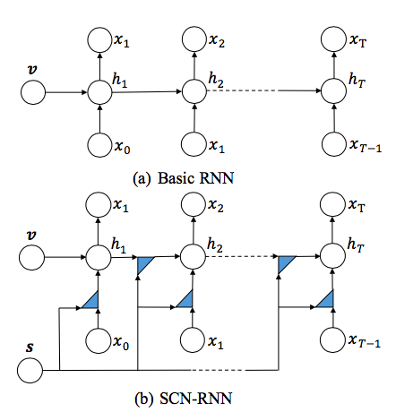

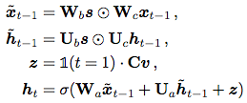
i-VisionGroup
Tsinghua
Method
Use the multi-label info weight the basis LSTM
weight matrices in the ensemble
To reduce the parameter:
Semantic Compositional Networks for Visual Captioning
Notes:
在attribute的使用方式上有所不同，一般attribute是把attribute直接作为LSTM的输入，此处是把attribute维度的概率用于加权LSTM输入的embedding矩阵，
Attribute有k个维度，就把原来一个embedding矩阵变成k个embedding矩阵的加权，
K通常很大，为了减小计算量，运算时用矩阵分解的方式做了一个维度缩减；

Slide 24
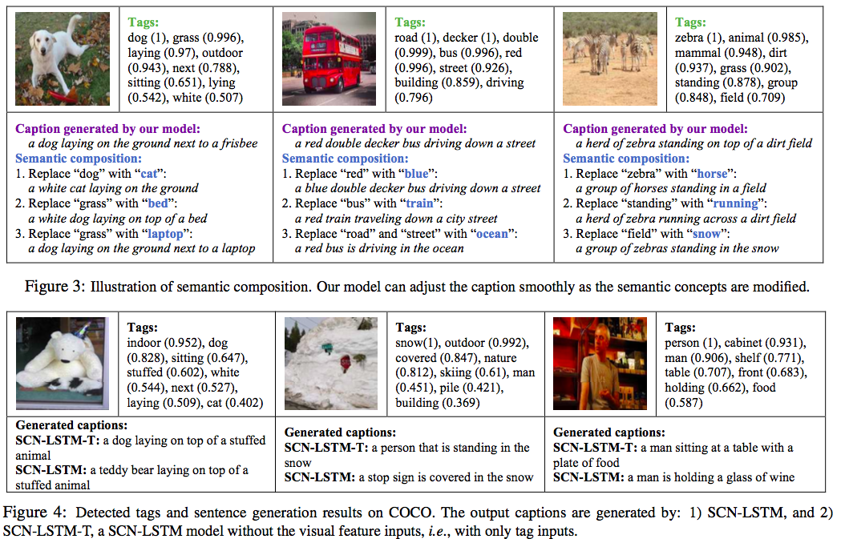
i-VisionGroup
Tsinghua
Experimental Result
Semantic Compositional Networks for Visual Captioning

Slide 25
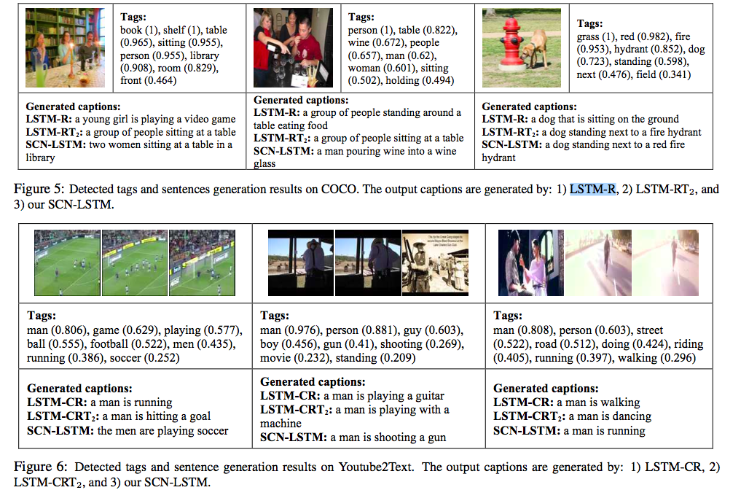
i-VisionGroup
Tsinghua
Experimental Result
LSTM-R / LSTM-T / LSTM-RT: R denotes ResNet visual feature vector, T denotes Tags, and RT denotes the concatenation of R and T.
LSTM-RT₂: The ResNet feature vector is sent to a standard LSTM decoder at the first time step, while the tag vector is sent to the LSTM decoder at every time step in addition to the input word.
SCN-LSTM :The proposed model
Semantic Compositional Networks for Visual Captioning

Slide 26
i-VisionGroup
Tsinghua
SCA-CNN: Spatial and Channel-wise Attention in Convolutional Networks for Image Captioning
Authors: Long Chen Hanwang Zhang Jun Xiao Liqiang Nie Jian Shao
Lab: Zhejiang University Columbia University Shandong University
Tencent AI Lab National U of Singapore
Source: CVPR’17 (poster)

Slide 27
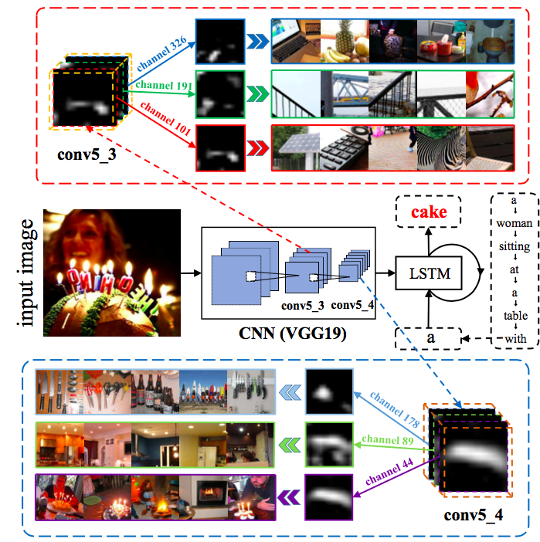
i-VisionGroup
Tsinghua
Contributions
Spatial attention: where to focus
Channel-wise attention: channel-wise, what to focus
Contributions:
1.Combine spatial & channel wise (can be viewed as semantic) attention in multiple layers
2.Better understanding of where and what the attention looks like in CNN
SCA-CNN: Spatial and Channel-wise Attention in Convolutional Networks for Image Captioning
Notes:
本文主要关注attention方法
一般的attention是spatial attention，
我们从一张图卷积得到c个feature map，每个feature map是m*n维的，
那么我们把这c个feature map在同一个（x,y）坐标的像素展成一个c维的向量作为（x,y）这个点对应的attention向量，总共有m*n个attention向量，
在后续运算中，每次计算权重，关注不同的attention；
本文引入channel wise的attention，即把卷积得到的每个feature map展成一个m*n维的向量，一共有c（channel）个attention向量，
这样做的道理是卷积学习图片特征的时候，往往不同的feature map会学到不同的特征，比如图中，栏杆，格子，蛋糕等等，所以有必要关注channel attention；

Slide 28
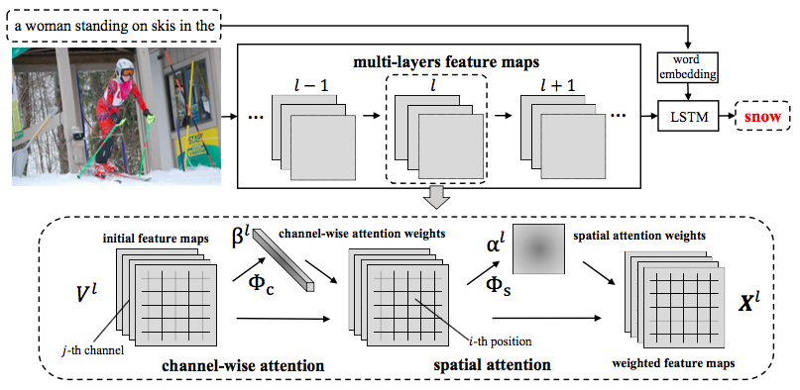
i-VisionGroup
Tsinghua
Method
SCA-CNN: Spatial and Channel-wise Attention in Convolutional Networks for Image Captioning
Notes:
区别于以往attention是把不同attention的加权作为后续LSTM的输入，
本文直接对CNN卷积图片得到feature map的过程改进，对不同layers的feature map 的像素进行加权，
为了减小计算量，我们分开应用channel 和spatial的attention，先应用channel-wise的attention，再应用spatial attention，
Channel attention中我们学习得到c维的beta权重，分别加权c维的channel attention 向量的每个元素，
Spatial attetnion中我们学习的到m*n维的alpha权重，分别加权m*n维的spatial attention 向量的每个元素；

Slide 29
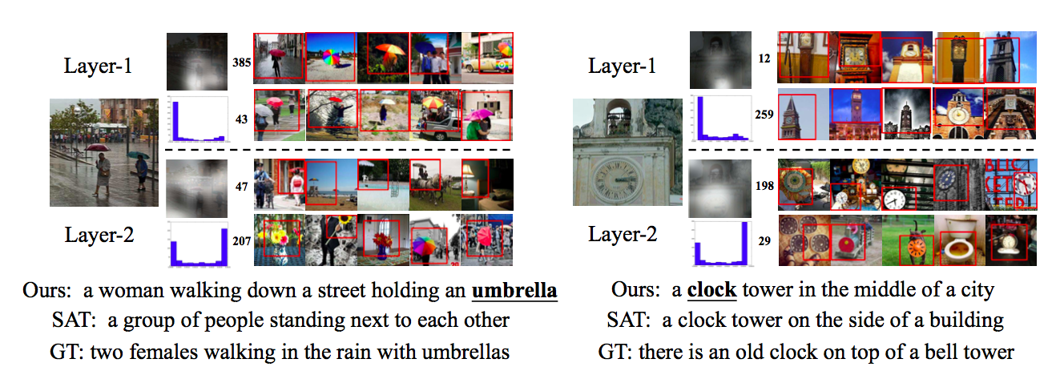
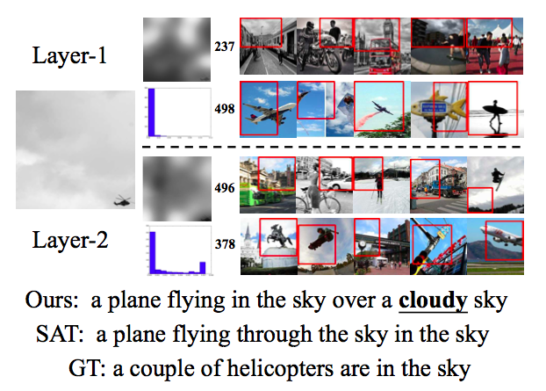
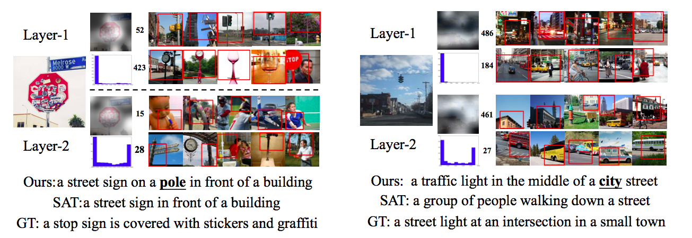
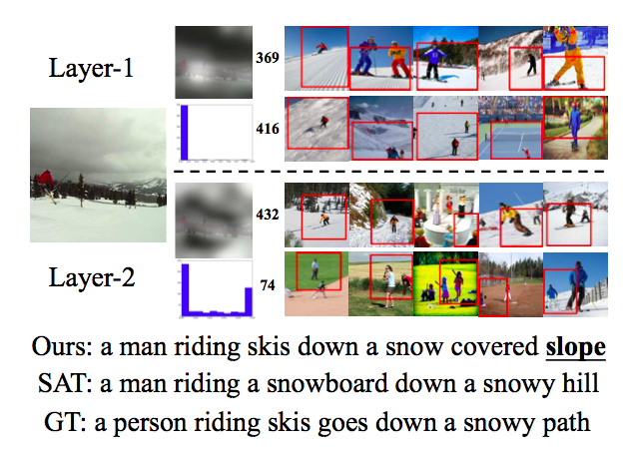
i-VisionGroup
Tsinghua
Experimental Result
SCA-CNN: Spatial and Channel-wise Attention in Convolutional Networks for Image Captioning

Slide 30
i-VisionGroup
Tsinghua
Skeleton Key: Image Captioning by Skeleton-Attribute Decomposition
Authors: Yufei Wang Zhe Lin Xiaohui Shen Scott Cohen Carrison W. Cottrell
Lab: Gary's Unbelievable Research Unit of ECE Department at UC San Diego
Source: CVPR’17 (poster)

Slide 31
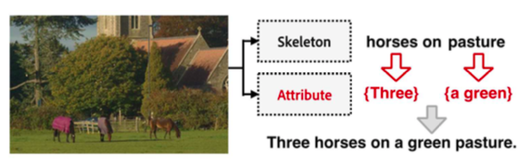
i-VisionGroup
Tsinghua
Contributions
Decompose the original image description into a skeleton sentence &attributes
Generates the skeleton and attributes separately according to user preference
Skeleton Key: Image Captioning by Skeleton-Attribute Decomposition
Notes:
主要思想是一个描述句子中有主干部分和附加部分，我们把两部分分别提取出来，分别学习，
比如 three horses on a green pasture
主干是horses on pasture,three用于修饰horses，a green用于修饰pasture
我们分别训练一个LSTM输入图片学习skeleton部分，和输入图片和skeleton的word学习attribute；

Slide 32

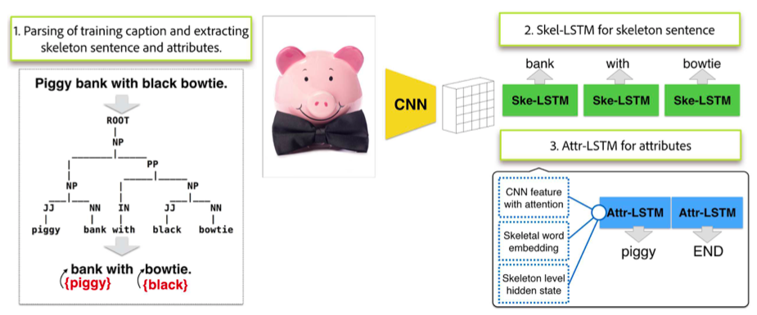
i-VisionGroup
Tsinghua
Method
Skel LSTM: just as traditional LSTM
Attr LSTM: use information from skel LSTM:
Skeleton Key: Image Captioning by Skeleton-Attribute Decomposition
Notes:
在训练skelton的LSTM使用了soft-attention方法（之前讲过，就是对图片特征的不同attention加权作为后续输入）
在训练attribute的LSTM时同样输入attentiond的图片特征，此外，还输入当前的skelton word和学习当前skelton word时的隐层（隐层代表关注context上下文信息）

Slide 33
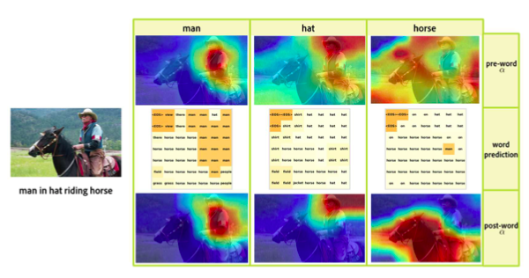
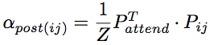
i-VisionGroup
Tsinghua
Method
Attention refinement
Skeleton Key: Image Captioning by Skeleton-Attribute Decomposition
Notes:
对attribute LSTM的图片attention进行改进，
一般的attention是从当前关注的attention和当前的hidden layer学习得到的，称为pre-word attention
本文的attention是用ppt中公式计算的，其中Pattend是Skel LSTM在t-1时刻的输出，是vocabulary size维度的概率，表示下一个最可能的skel-word，
Pij是attention向量（vij）经过Skel-LSTM在t-1时刻的输出，是vocabulary size维度的概率，表示每一个vij最可能对应的下一个word，
只有当skel-word和vij对应的word一致时，相应的vij的aplha最大，
Z是归一化因子，因为在计算中用到了预测的下一个可能的词，我们成为post-word的attention
效果如图，关注区域更准确

Slide 34
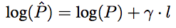
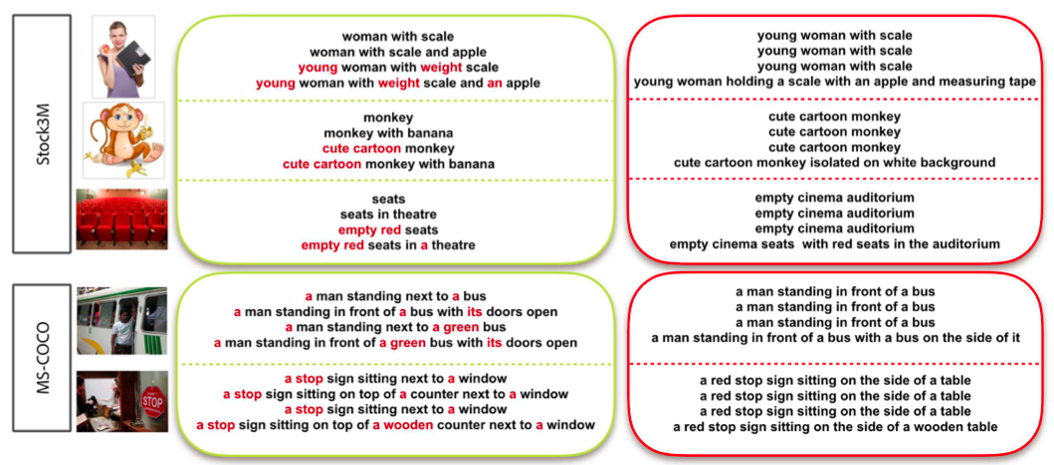
i-VisionGroup
Tsinghua
Experimental Result
Control the length of these two part with r:
Skeleton Key: Image Captioning by Skeleton-Attribute Decomposition
Notes:
本文的一个小trick，为了避免得到的句子过短，l表示句子长度，意思是每生成一个词，我们在对数概率上加一个r，句子越长，概率就倾向越大，
这样长句的概率就会更大，来影响beam search 的结果选择；

Slide 35
i-VisionGroup
Tsinghua
Incorporating Copying Mechanism in Image Captioning for
Learning Novel Objects
Authors: Ting Yao Yingwei Pan Yehao Li Tao Mei
Lab: Microsoft Research University of Science and technology of Chian
Sun Yat-Sen University
Source: CVPR’17 (poster)

Slide 36
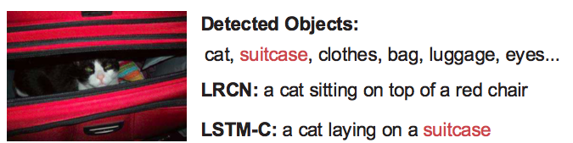
i-VisionGroup
Tsinghua
Contributions
A novel LSTM-C framework to generate words by integrating
“copy mechanism” using external sources
Incorporating Copying Mechanism in Image Captioning for Learning Novel Objects
Notes:
本文的主要关注在于novel caption的学习，一般caption标签构成的词库会比较普通，不包含一些特殊词，
我们引入额外的词库来从图片中学习到caption标签中没有的词，来更精准描述图片；

Slide 37
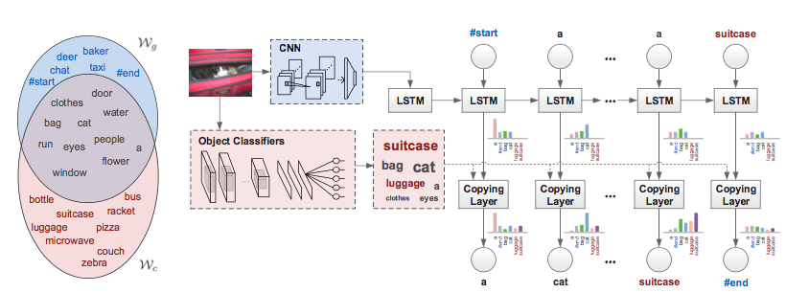



i-VisionGroup
Tsinghua
Method
Use MIL in a new dataset to gain a new vocabulary set
Calculate the target word considering both two set
Incorporating Copying Mechanism in Image Captioning for Learning Novel Objects
Notes:
首先我们有wg是caption标签组成的词库，额外，我们使用Wc是object detection任务引入的词库，二者有交集，也有各自不同的部分；
学习网络由两部分组成，第一部分是一般的LSTM，使用Wg词库，预测下一个可能词的概率；
第二部分是用Wc词库对图片做MIL，得到图片中可能包含词的概率；
然后对于Wg并Wc的词库，我们根据一个词属于二者的哪一个部分，是公共部分还是各自独立的部分，用一个线性变换的公式来整合以上两步得到的概率，
作为最终预测词的概率，选概率大的继续后面的预测。
到这里会发现一个问题，就是在损失函数的计算中，我们只取ground truth标签对应的概率进行计算，那么所有的groud truth都在Wg中，
我们就永远取不到只在Wc中才有的novel 词的，也就一直用不到公式中的第三行，也就没法更新这些词在网络中对应的参数，
对于这个问题，论文中轻描淡写地引用了一篇参考文献，有待研究。

Slide 38



i-VisionGroup
Tsinghua
Experimental Result
Incorporating Copying Mechanism in Image Captioning for Learning Novel Objects

Slide 39
i-VisionGroup
Tsinghua
Results on COCO
 | CIDEr | Rouge-L | Meteor | BLEU-1 | BLEU-2 | BLEU-3 | BLEU-4
Actor-critic | 0.973 | 0.525 | 0.247 | 0.713 | 0.539 | 0.403 | 0.304
SCST | 1.114 | 0.553 | 0.263 | - | - | - | 0.333
SCST† | 1.147 | 0.563 | 0.27 | 0.781 | 0.619 | 0.47 | 0.352
When to look | 1.085 | - | 0.266 | 0.742 | 0.58 | 0.439 | 0.332
When to look† | 1.042 | 0.550 | 0.264 | 0.748 | 0.584 | 0.444 | 0.336
SCN-LSTM | 1.012 | - | 0.257 | 0.728 | 0.566 | 0.433 | 0.330
SCN-LSTM† | 1.003 | 0.543 | 0.257 | 0.740 | 0.575 | 0.436 | 0.331
SCA-CNN | 0.912 | 0.524 | 0.244 | 0.712 | 0.542 | 0.404 | 0.302
Coarse-to fine | 0.966 | 0.489 | 0.247 | 0.673 | 0.489 | 0.355 | 0.259
Data from http://mscoco.org/dataset/#captions-leaderboard

Slide 40
i-VisionGroup
Tsinghua
Results on Flicker30
 | CIDEr | Rouge-L | Meteor | BLEU-1 | BLEU-2 | BLEU-3 | BLEU-4
When to look | 0.531 | - | 0.204 | 0.677 | 0.494 | 0.354 | 0.251
SCN-LSTM | - | - | 0.218 | 0.735 | 0.530 | 0.377 | 0.265
SCN-LSTM† | - | - | 0.223 | 0.747 | 0.552 | 0.403 | 0.288
SCA-CNN | - | - | 0.195 | 0.662 | 0.468 | 0.325 | 0.223
Data from http://mscoco.org/dataset/#captions-leaderboard

Slide 41
i-VisionGroup
Tsinghua
 | ImageCaption组工作总结
李舒燕 | ImageCaption方面论文的泛读和四篇用到增强学习的论文精读，学习了有关policy gradient以及tensorflow和torch库的知识，跑通了基于torch库的self-critical这篇论文的代码。然后目前的计划是将增强学习进一步用到imagecaption中。
许海华 | MIL方法学习，竞赛baseline（NIC）代码阅读，尝试加入attribute，Faster R-CNN代码阅读（数据读取部分完成）
尹帮户 | show，attend and tell代码阅读，学习GPU并行，了解量化和近似最近邻搜索技术
戚怀宇 | Python基础学完，吴恩达机器学习视频线性回归逻辑回归看完，线性回归matlab作业做完，逻辑回归matlab作业在做，参加中文图像描述竞赛，课程作业较多。

